Slide 1

Internship Presentation “Multi-website automated scraping tool for real-time data extraction”
UNDER THE GUIDANCE OF:
Industry Mentor
Mr Amit Kumar Mishra, Director, EY GVT Gurgaon Mr Shivansh Dubey, Sr Analyst, EY GVT Gurgaon
Faculty Mentor
Dr Ankit Mahindroo Assistant Professor, LMTSM
Submitted to:
Dr. Amit K. Bhardwaj
Dr. Manjot Singh Bhatia
Submitted by:
Akkshit Kumar (502104009)

Slide 2
Questions to be answered
Why EY
What were the activities performed…?
Learning Outcomes
Daily Operations

Slide 3
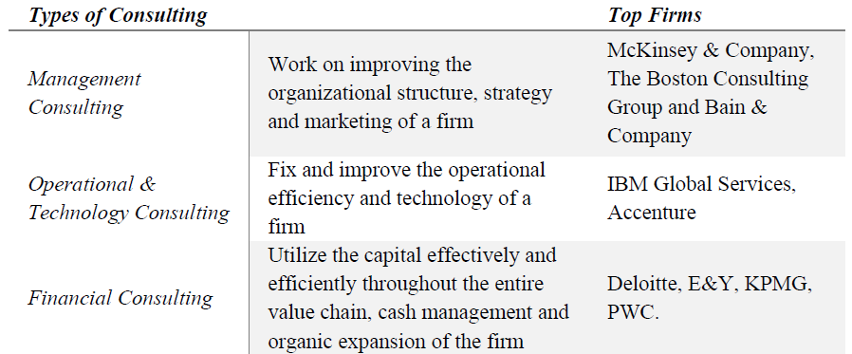
Industry Overview
The number of consulting firms rapidly increased over the following decades in the wake of the development of scientific management, operations, and organisational theory with revenues ranging from $800 billion to $900 billion.
Organisations have made significant progress in the last few decades in terms of developing internal advisory and implementation teams, internal consulting and project management teams, as well as typical "consulting" capabilities across important departments, functions, and process areas.
Consultants (especially those with specialised skills in computing science and other digital areas) will be in demand as the increase in digitization continues, hybrid working models become part of the "new normal," and companies increasingly turn to cloud computing.
The world's first contemporary consulting firms were established in the late 19th century, which is when the consulting industry first emerged.
The Indian consulting market has grown at a compound annual growth rate (CAGR) of 8.6% since 2014, and predicted to grow at a CAGR of 10.6% to reach nearly $1,460.2 billion by 2025, as per the Associated Chambers of Commerce and Industry.

Slide 4
Organizational Profile
EY exists to build a better working world, helping to create long-term value for clients, people and society, and to build trust in the capital markets.
Enabled by data and technology, diverse EY teams in over 150 countries provide trust through assurance and help clients grow, transform and operate.
Working across assurance, consulting, law, strategy, tax and transactions, EY teams ask better questions to find new answers to the complex issues facing our world today.
Address: Ernst and Young (EY), Golf View Corporate Tower B, Golf Course Rd, Sector 42, Gurugram, Haryana
Started in 1989. CEO: Mark Weinberger Net Revenue: 29.6 billion US dollars (2016) A workforce of more than 231,000.

Slide 5
About the Project
In this project several tasks to scrap, gather and garner as much data about the user input as per the chosen website were given.
- Web scraping modules creation,
- Generalizing the codes, debugging, manipulating data and, their compilation,
- Analyzing and visualizing,…….etc.
Studying the python libraries available to accomplish various tasks involved.
Finally, building the Graphical User Interface (GUI) and Tool.
This includes:

Slide 6
Methodology/Tasks
Analyze and Visualize the data.
Compilation of scraping scripts.
Form web scrapping modules.
Build user interface.
GUI automation for the tool.
Deliver the Final Tool.

Slide 7

What is Web Scrapping….?
Web scraping is an automatic method to obtain large amounts of data from websites.
Most of this data is unstructured data in an HTML format which is then converted into structured data in a spreadsheet or a database so that it can be used in various applications.
Libraries used:
BeautifulSoup, Selenium, Pandas, NumPy, Tkinter, etc…

Slide 8
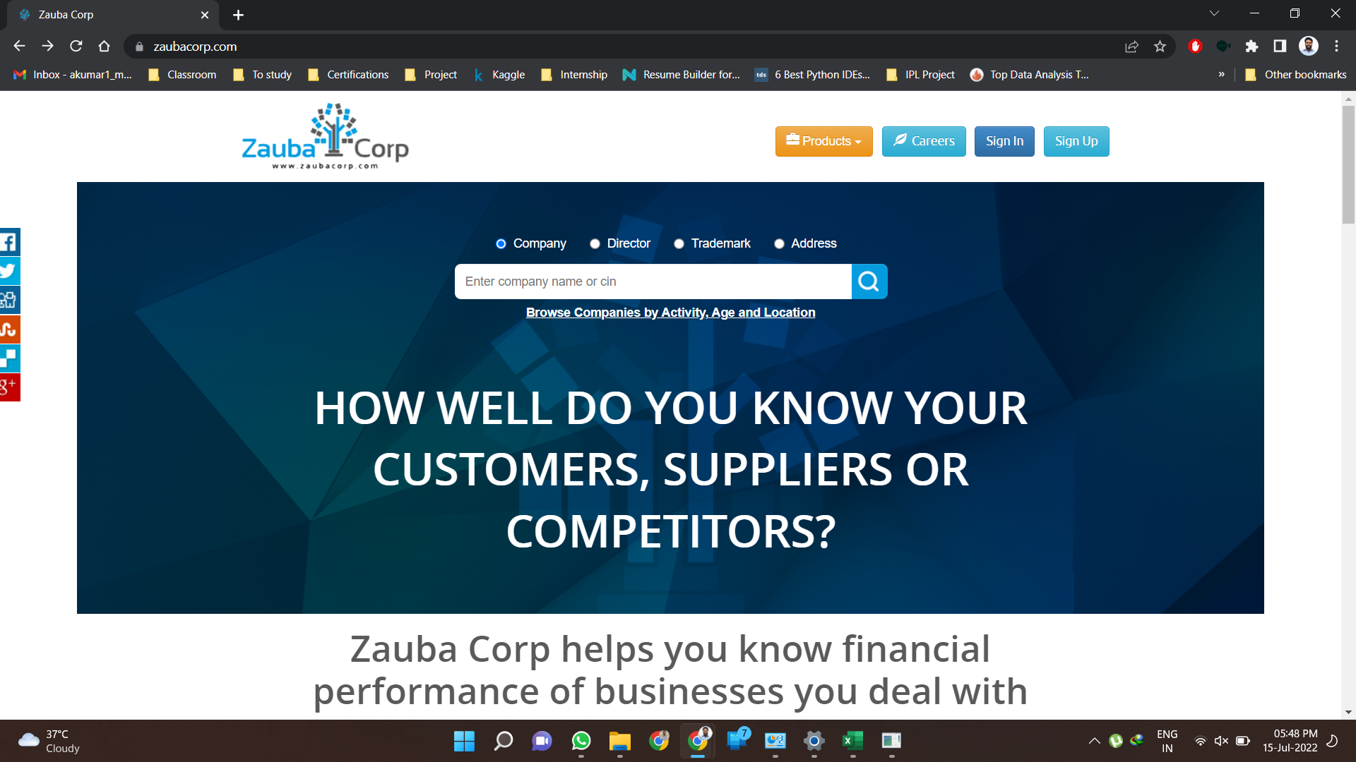
Activities

Slide 9
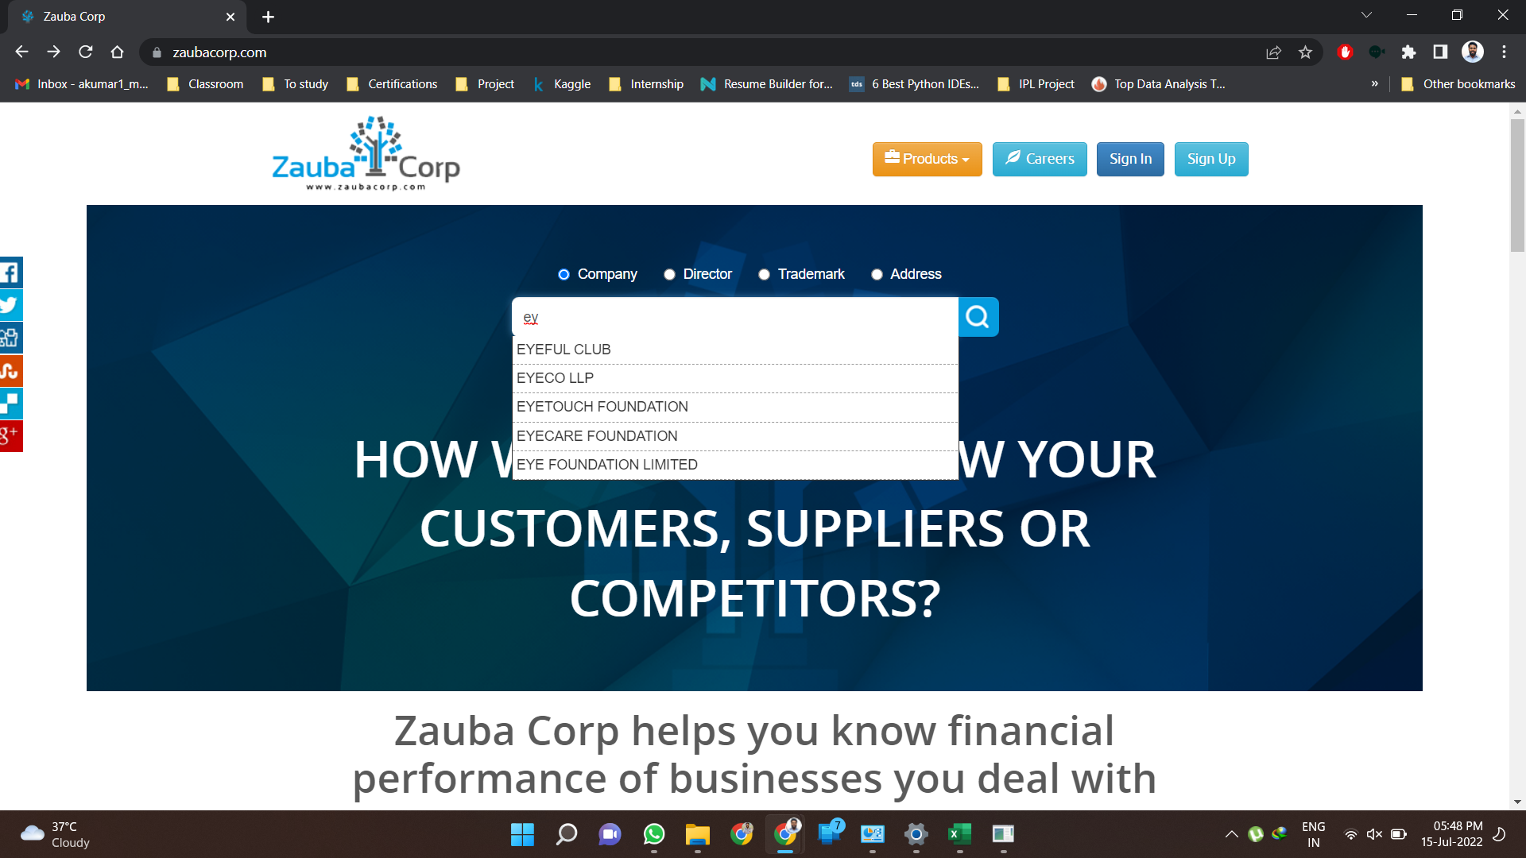

Slide 10
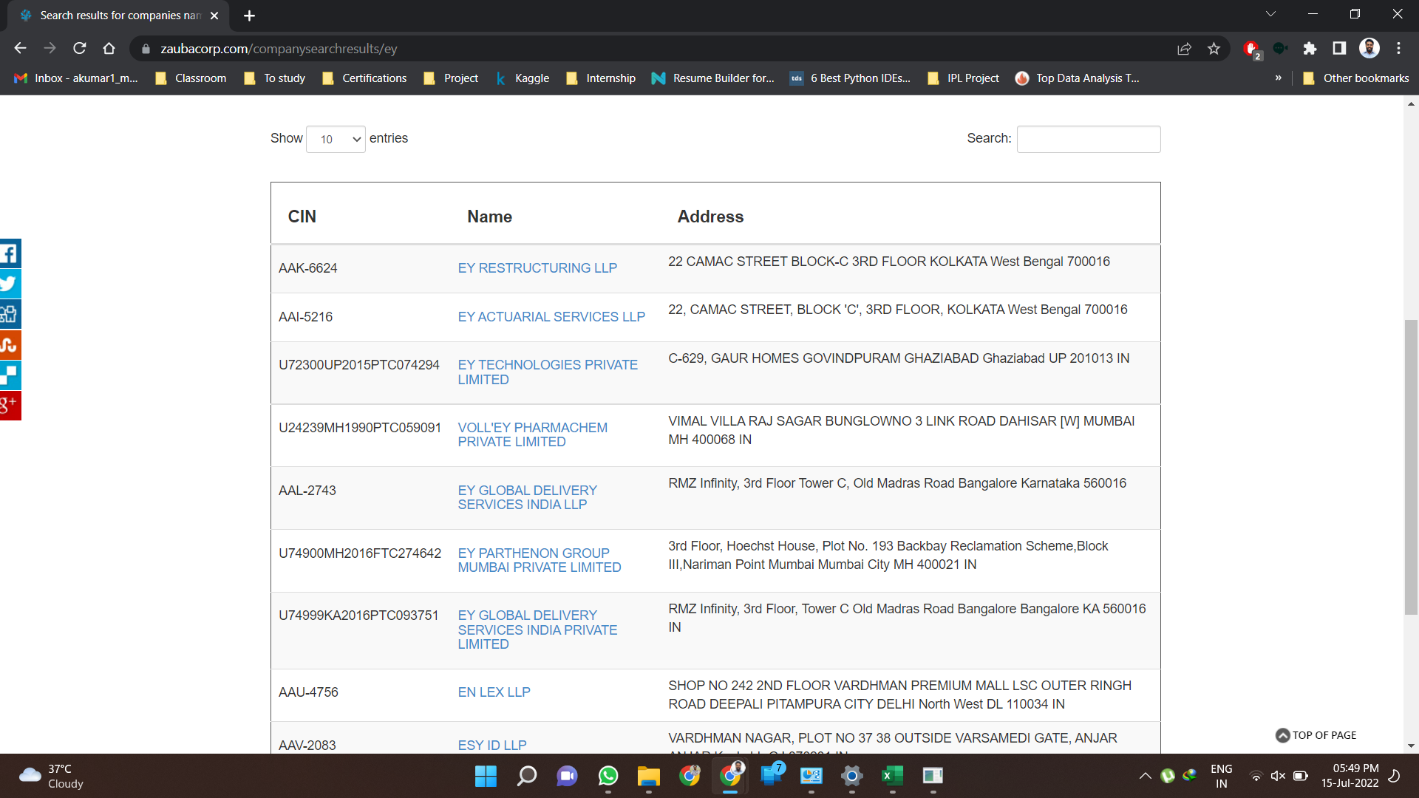

Slide 11
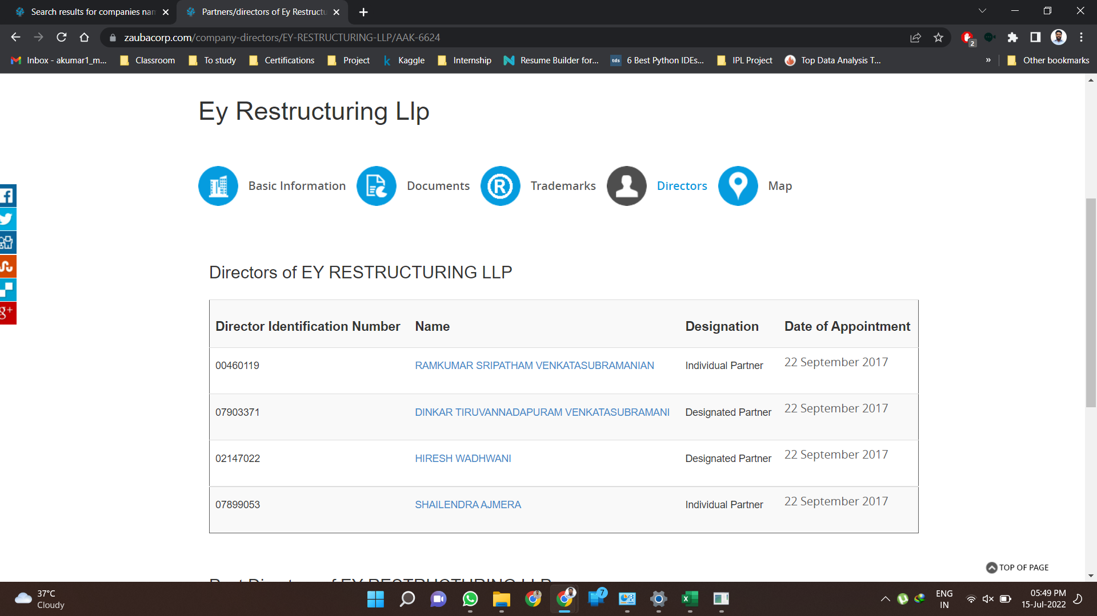

Slide 12
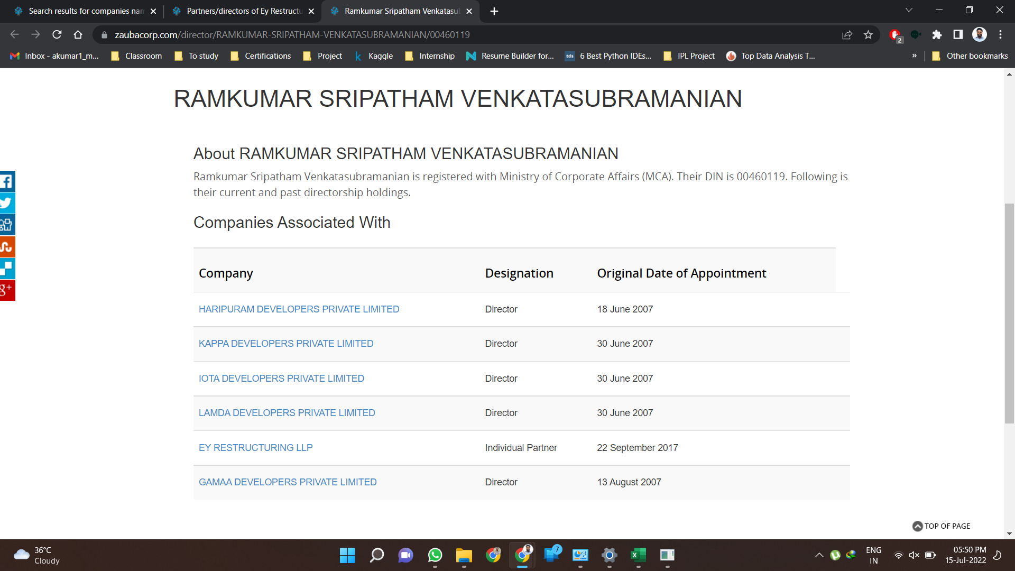

Slide 13
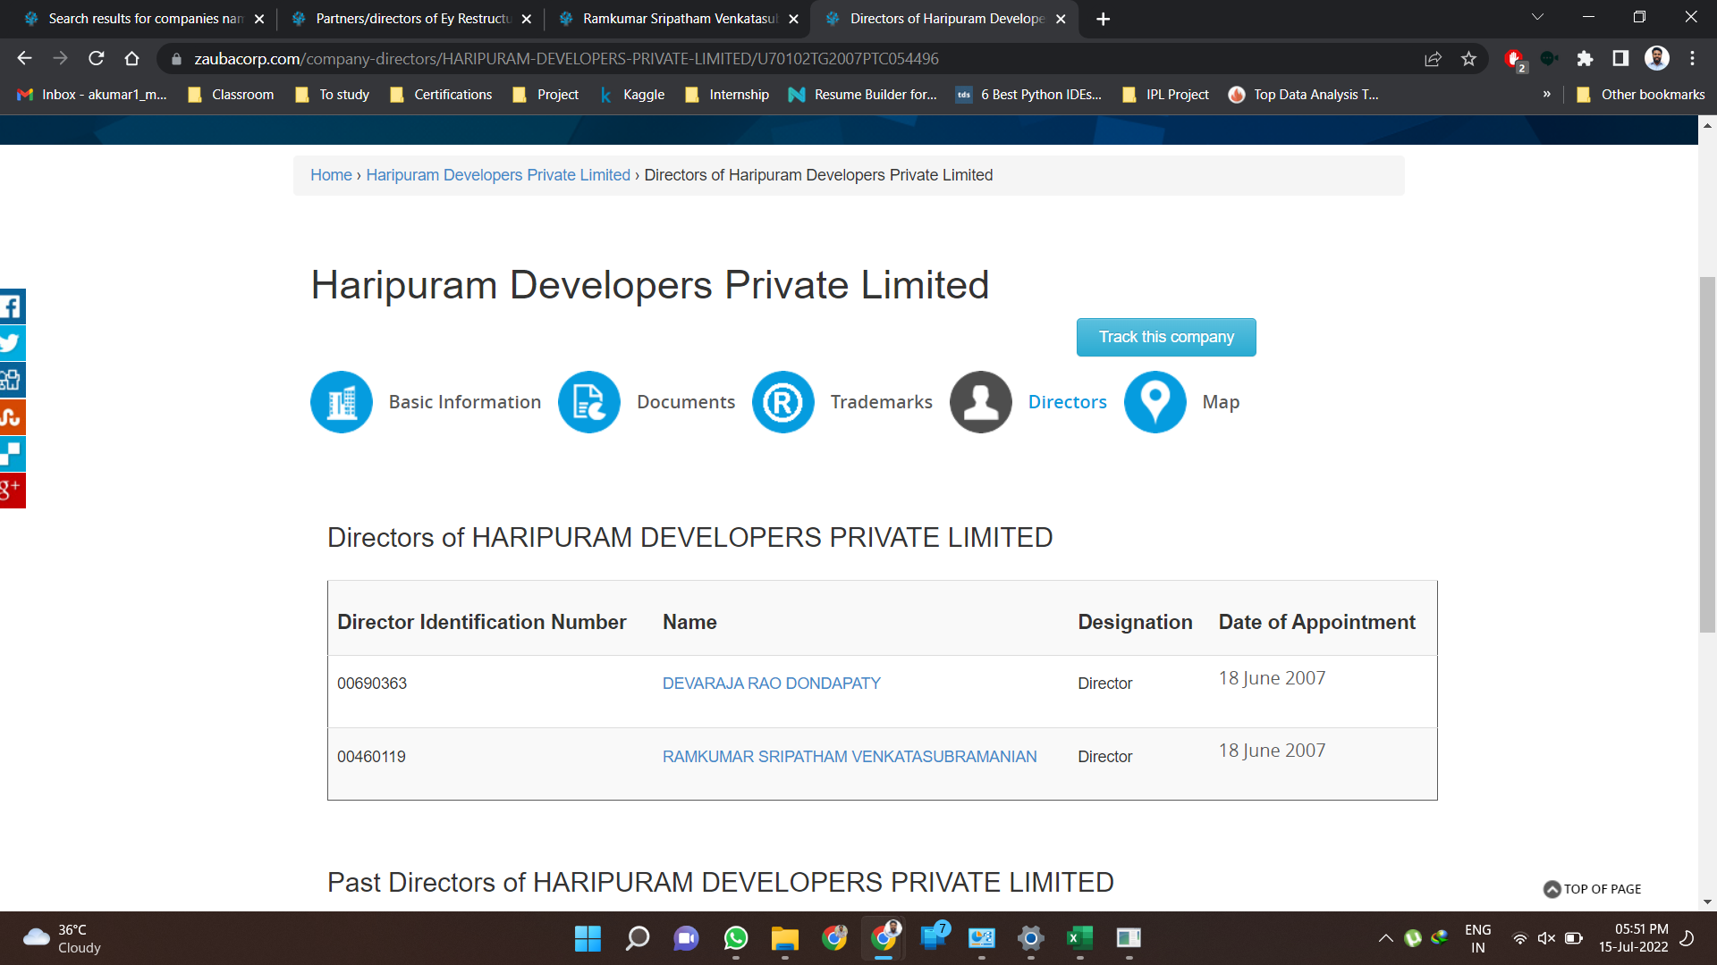

Slide 14
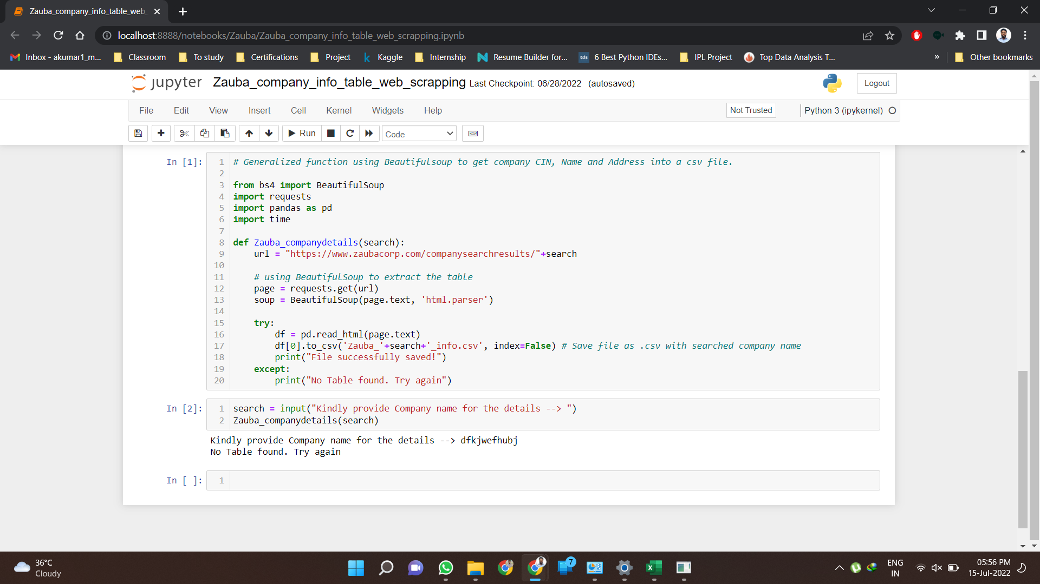
1.
Get the page information
2.
Read & Get the tables in the page.

Slide 15
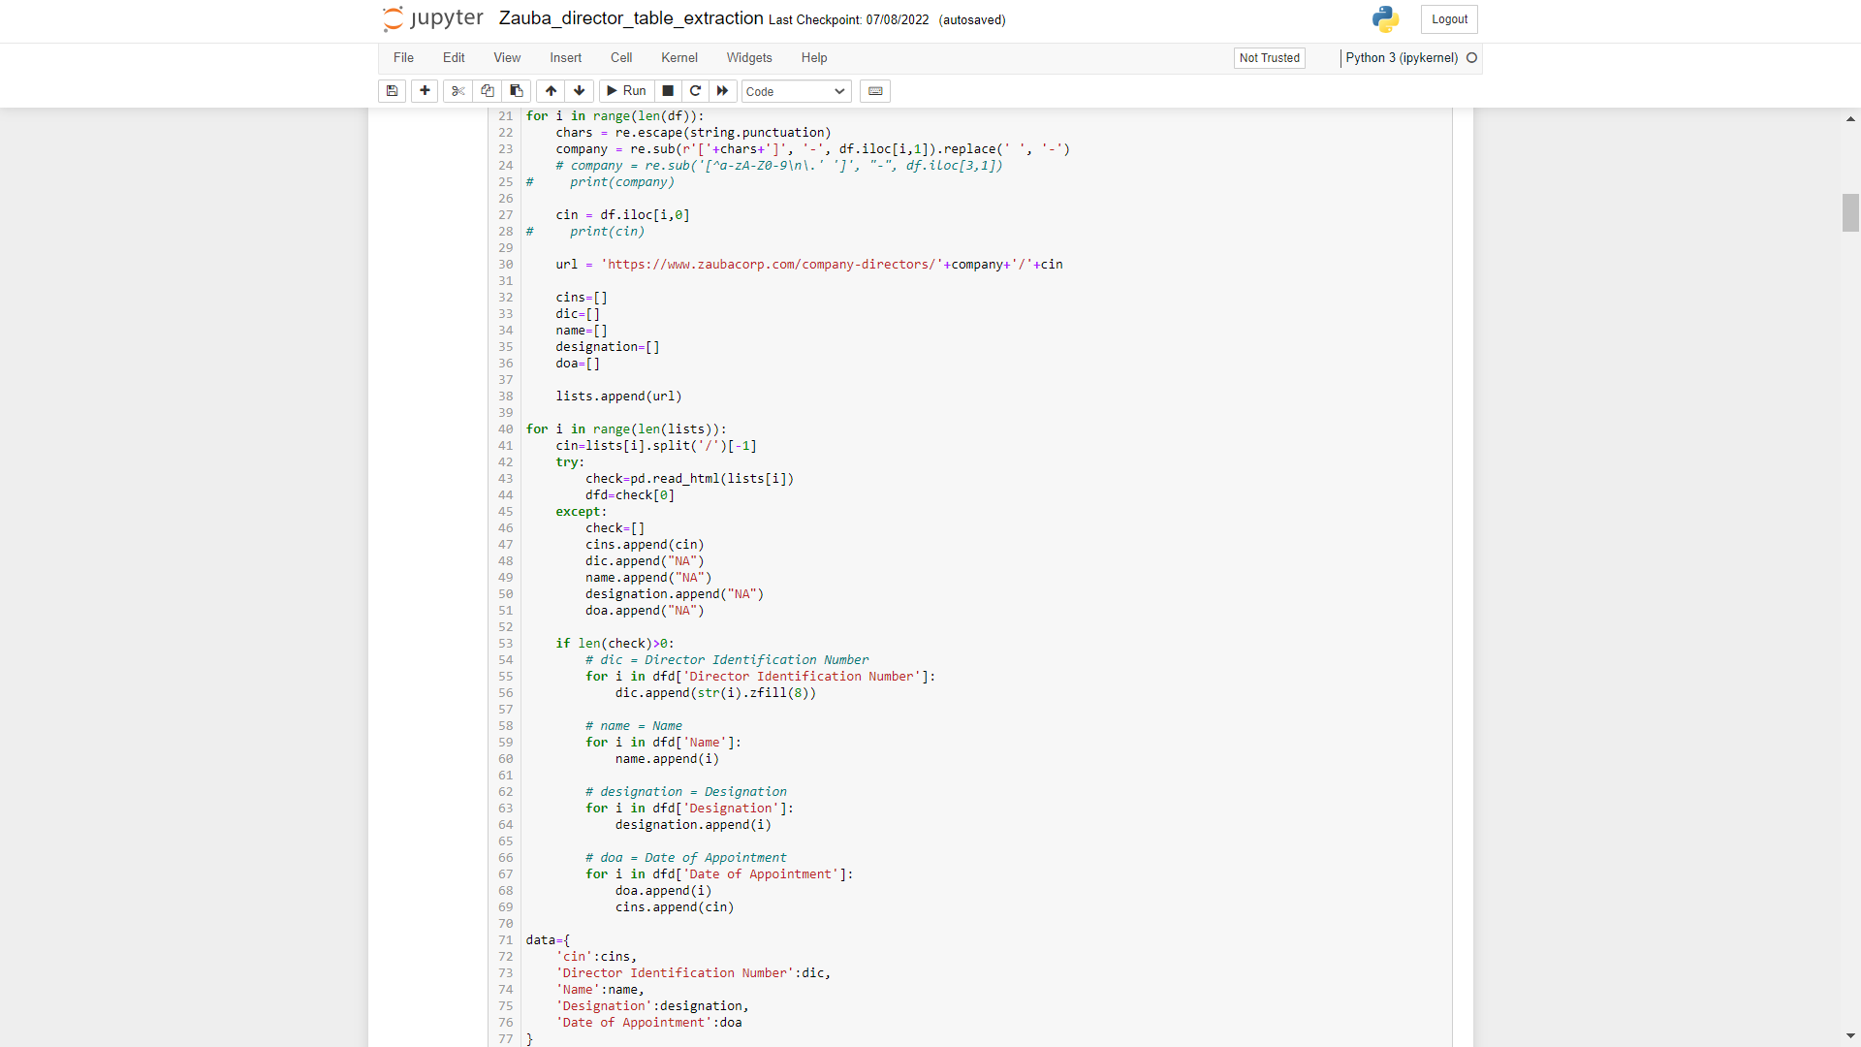
1.
Direct generalized link generator for getting Director Table for each Company
2.
If the table is present then save its details, else put ‘NA’ in the details columns

Slide 16
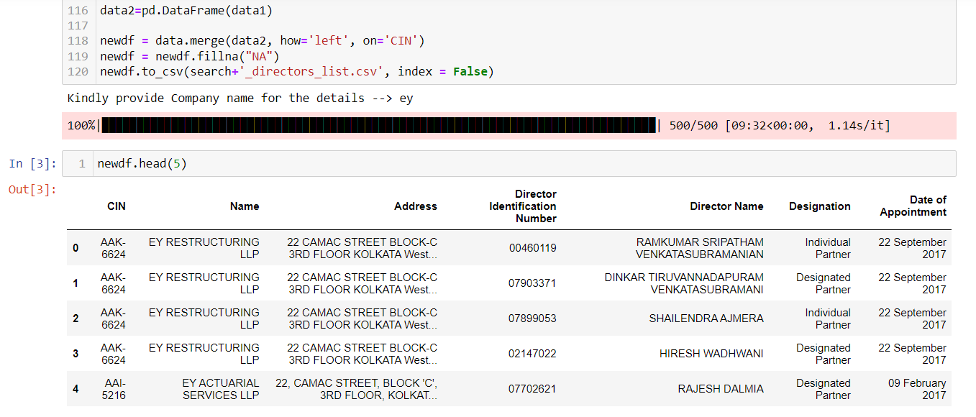
Merge and Join
Primary Key

Slide 17
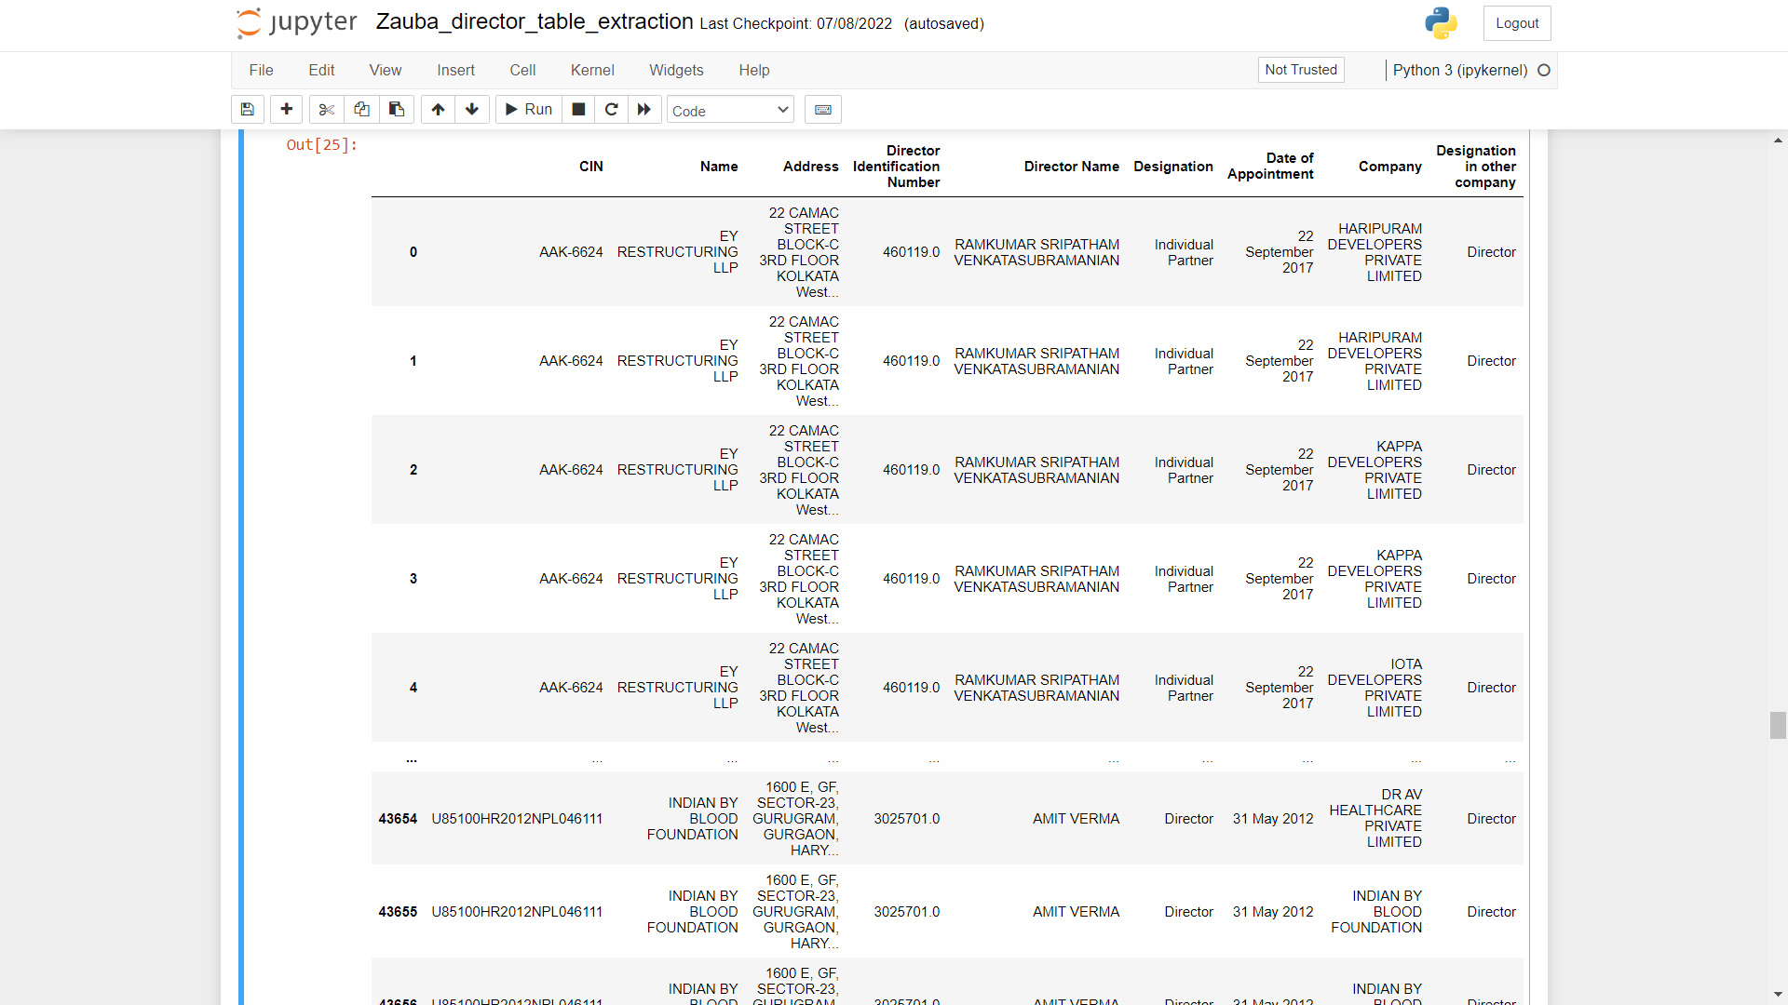
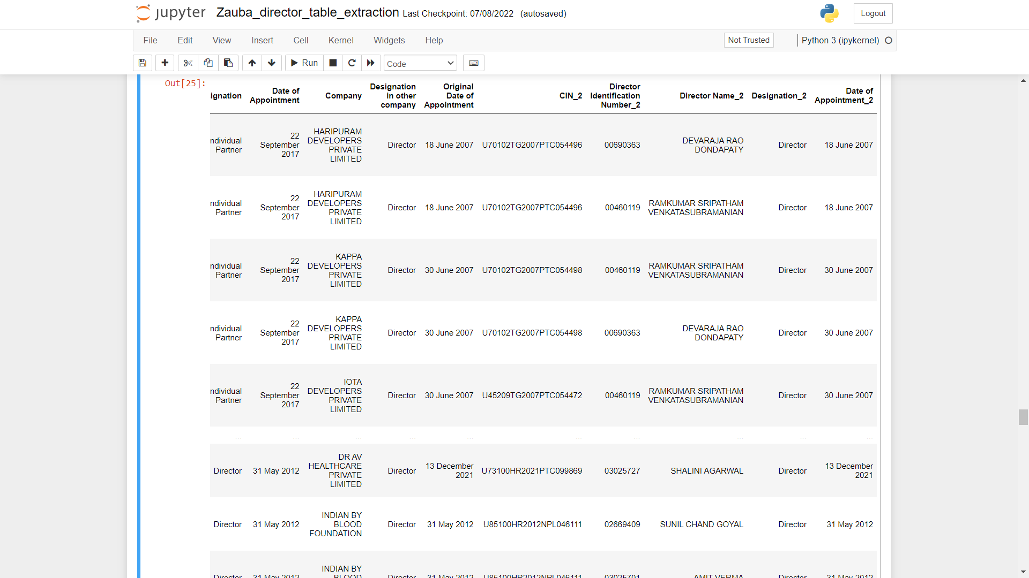
Level 1
Level 2
Level 3
Level 4

Slide 18
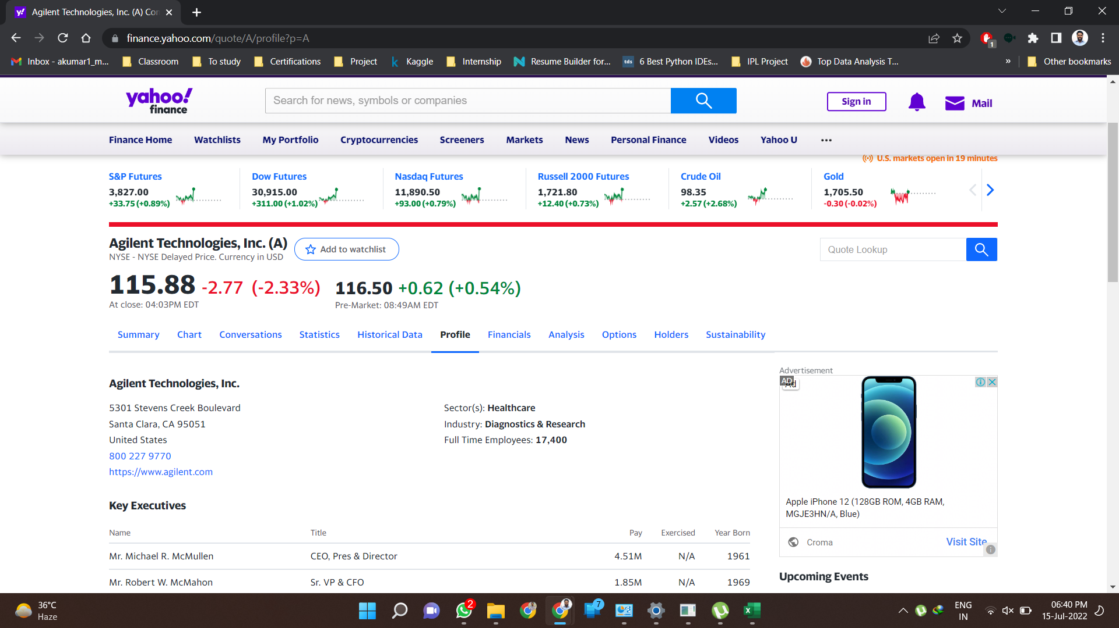
Java Script

Slide 19
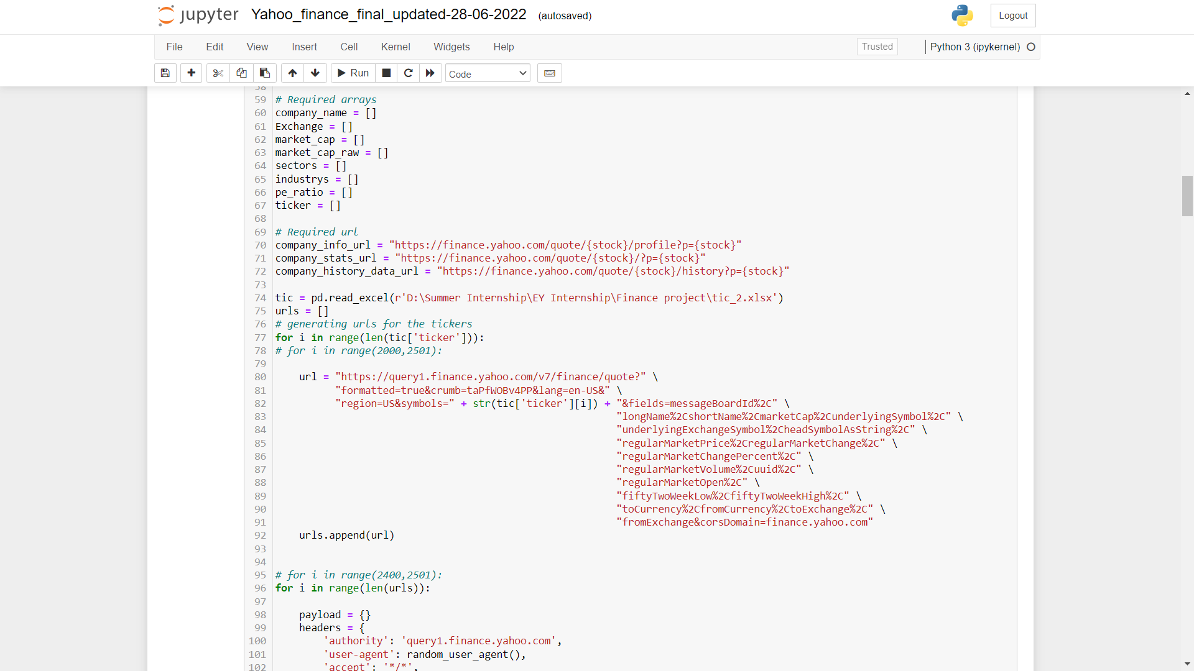
1.
Generalized links to scrap required data from.
2.
key:value pair outputs for scraping

Slide 20
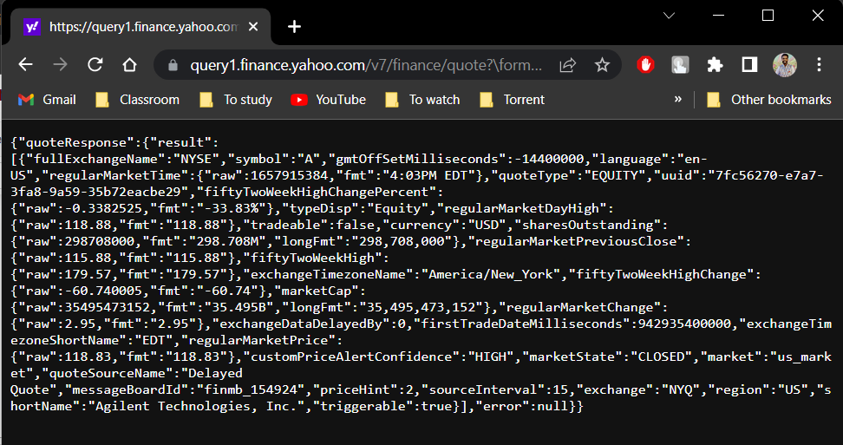
2. Output

Slide 21
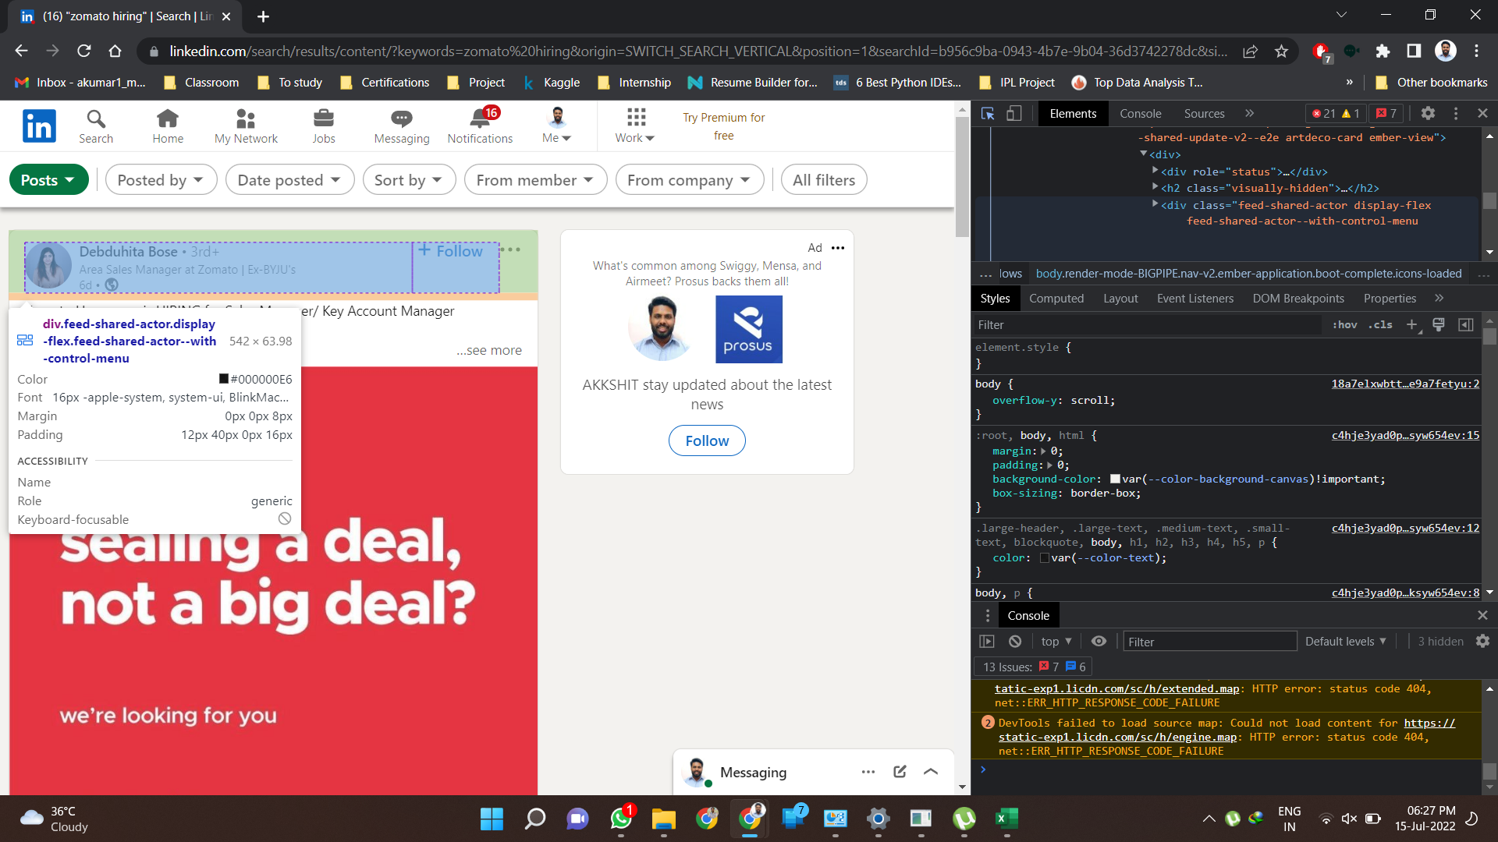
Search

Slide 22
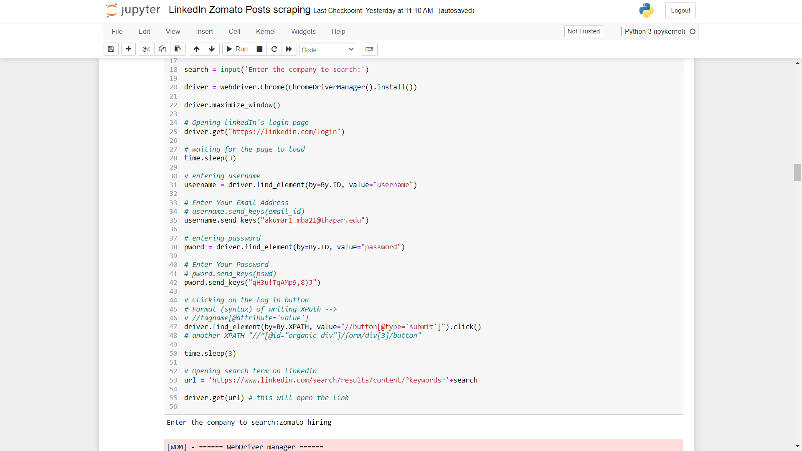
Open Chrome
X-Path

Slide 23
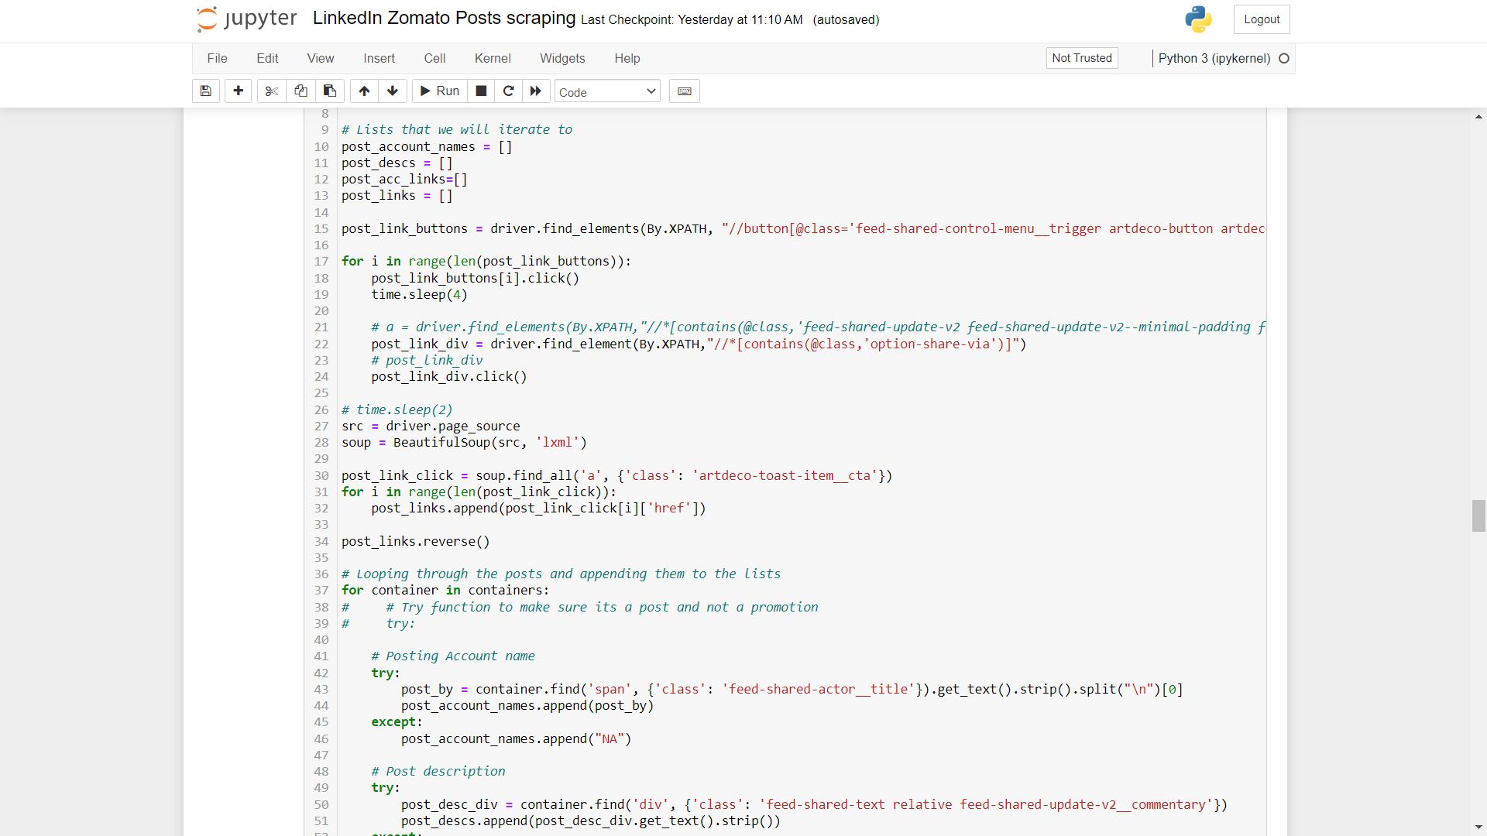
Find_all

Slide 24
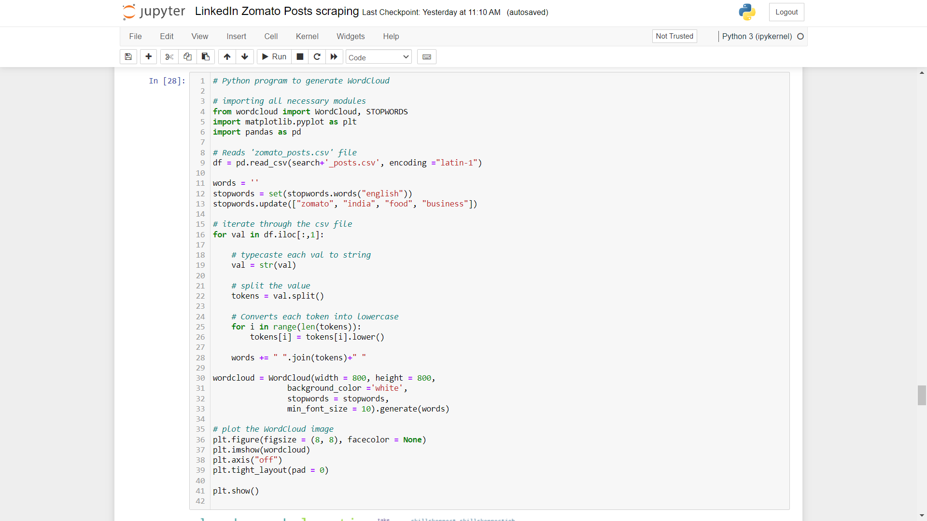
Word Cloud

Slide 25
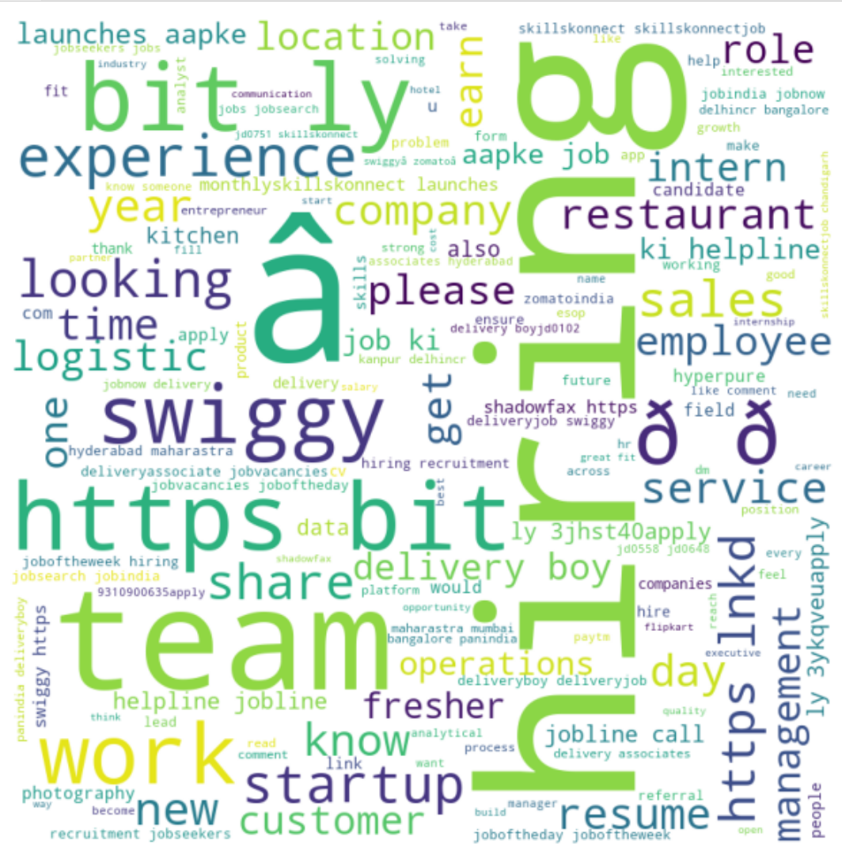
Word Cloud

Slide 26
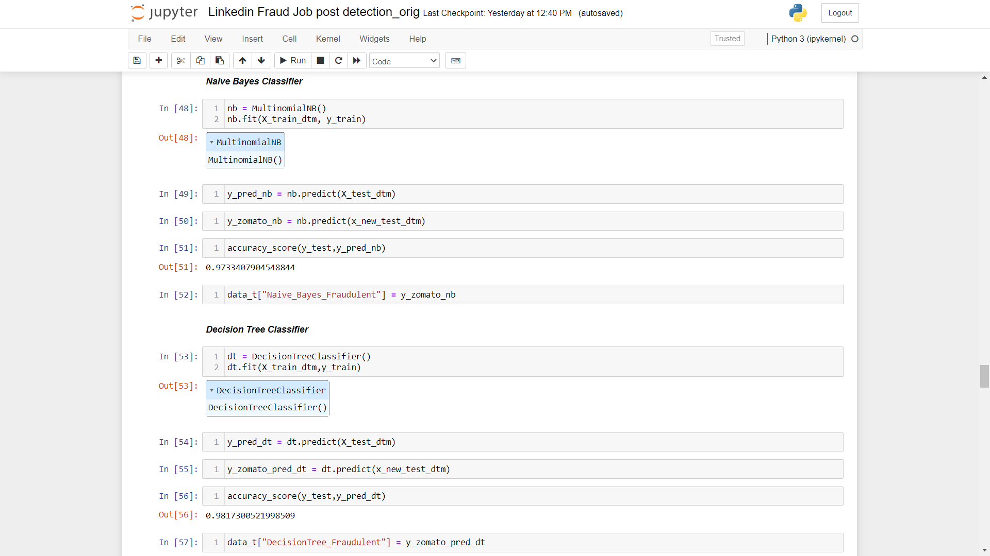

Slide 27
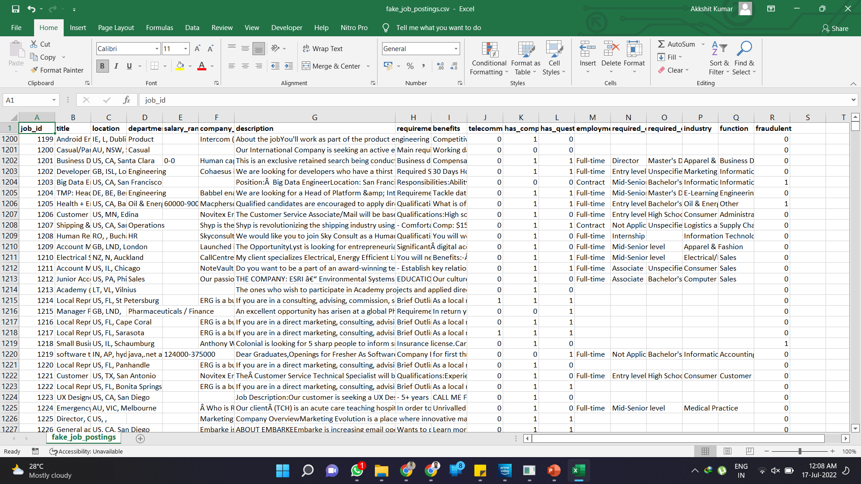
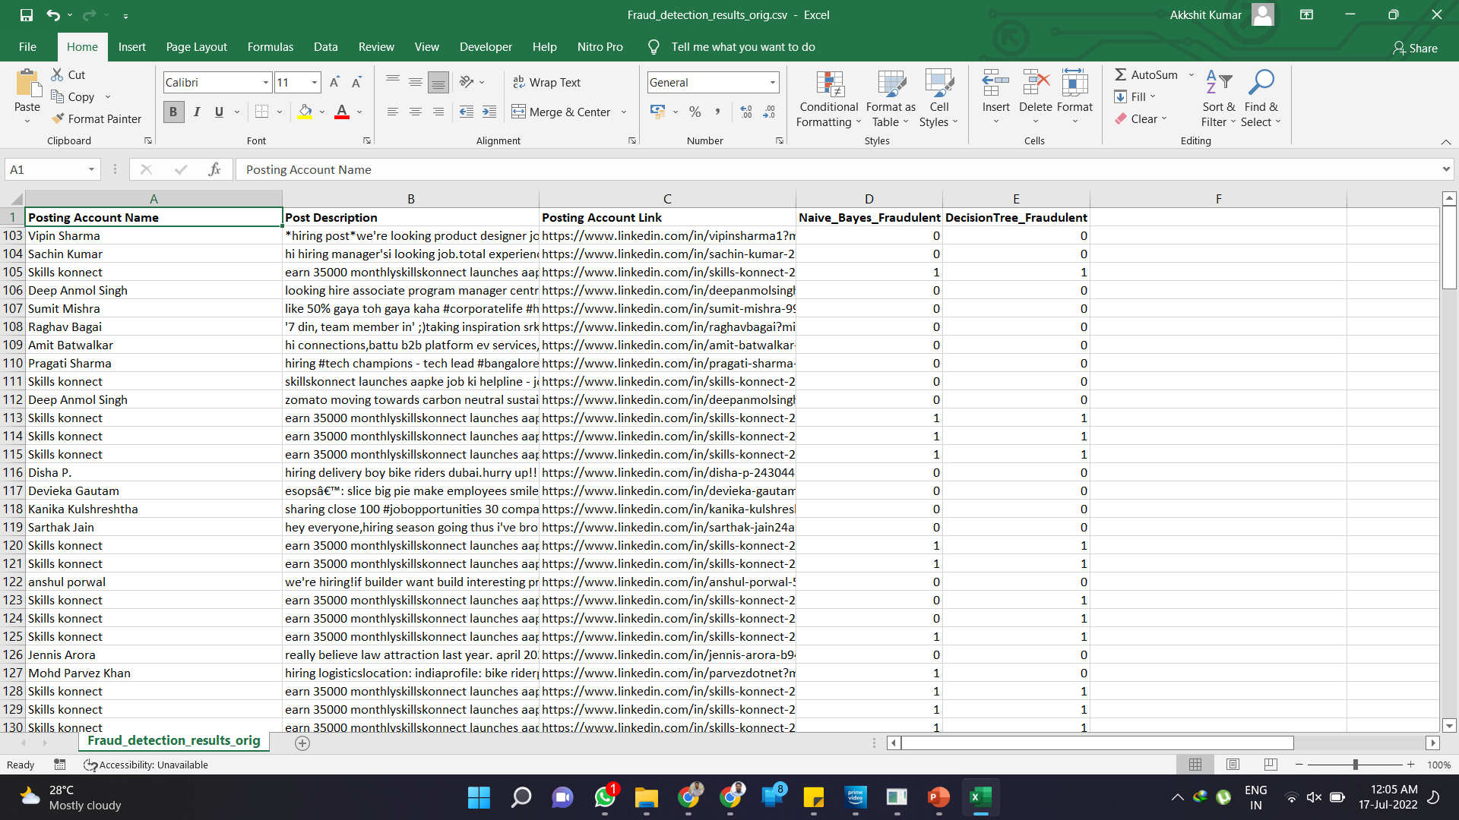
Datasets for Fraud Detection model
Train Dataset
Test Dataset
Real Job
Fake Job

Slide 28
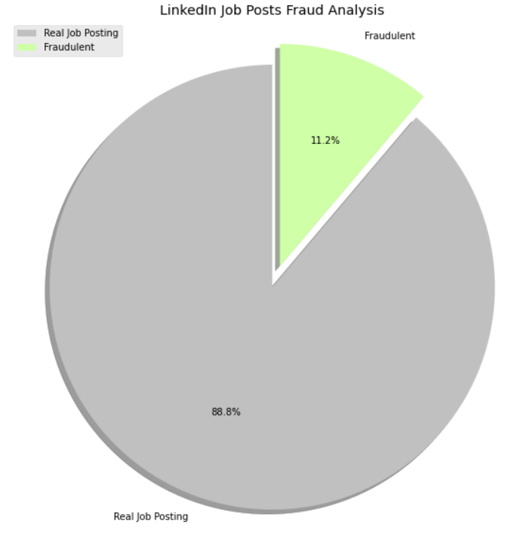
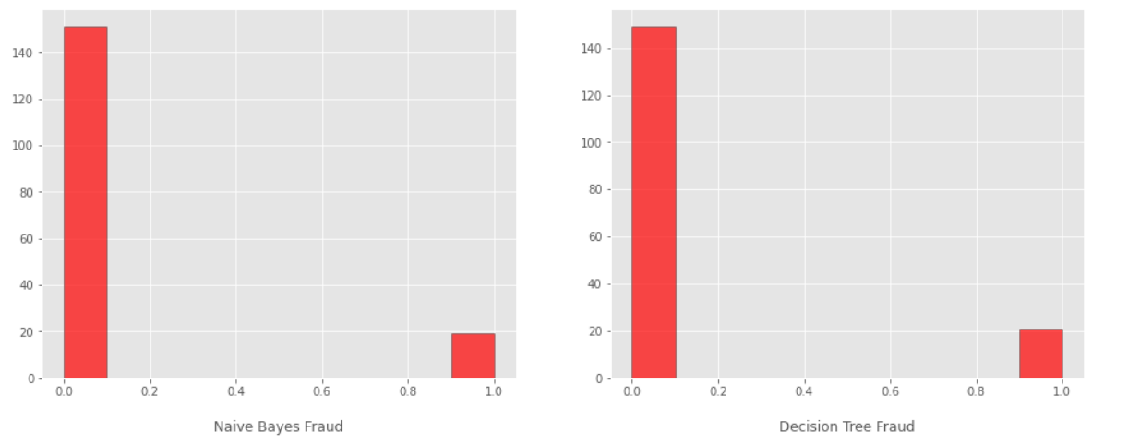
Visualizing Results of Test Data

Slide 29
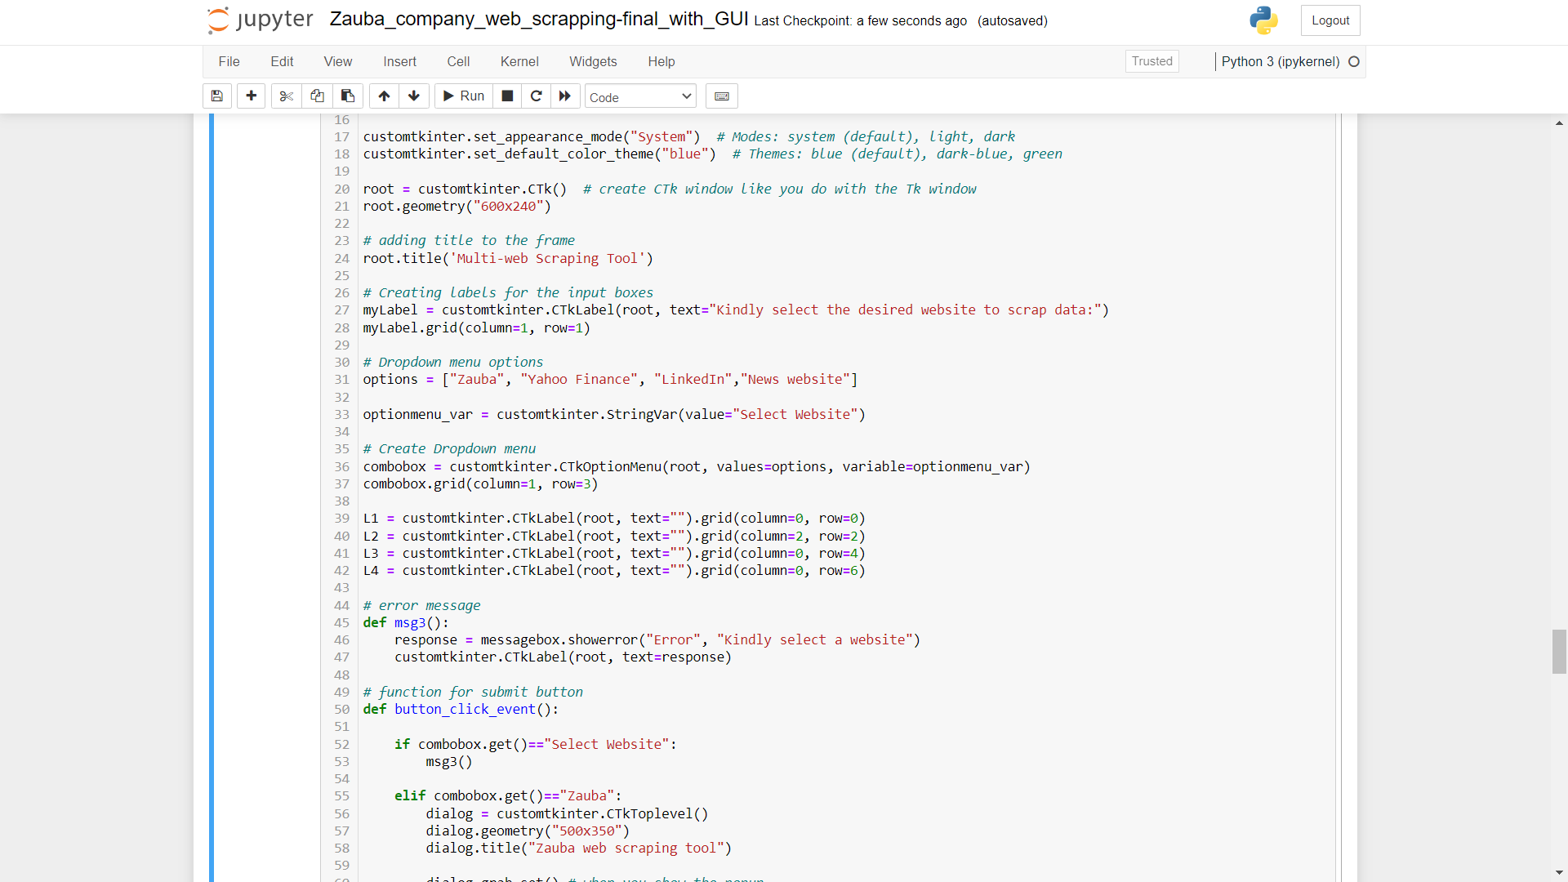
GUI codes

Slide 30
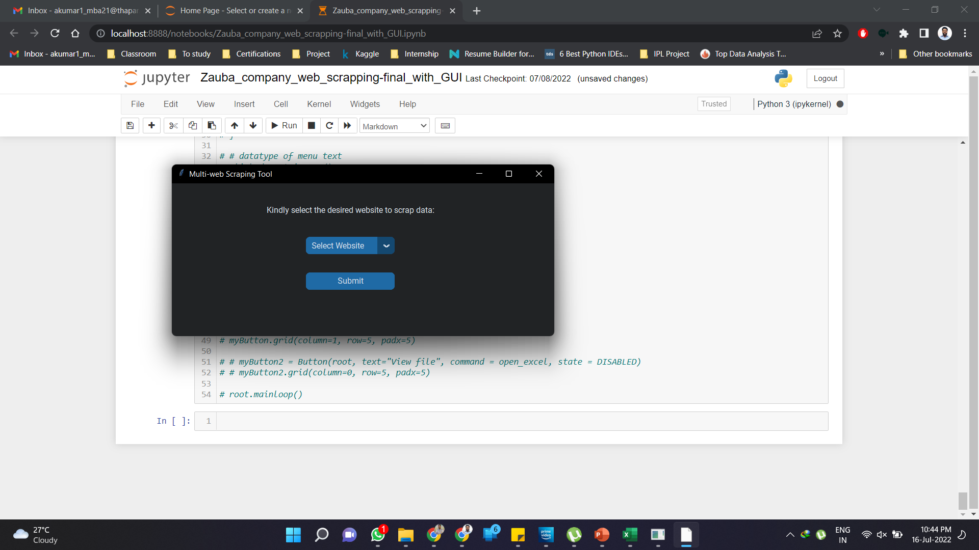
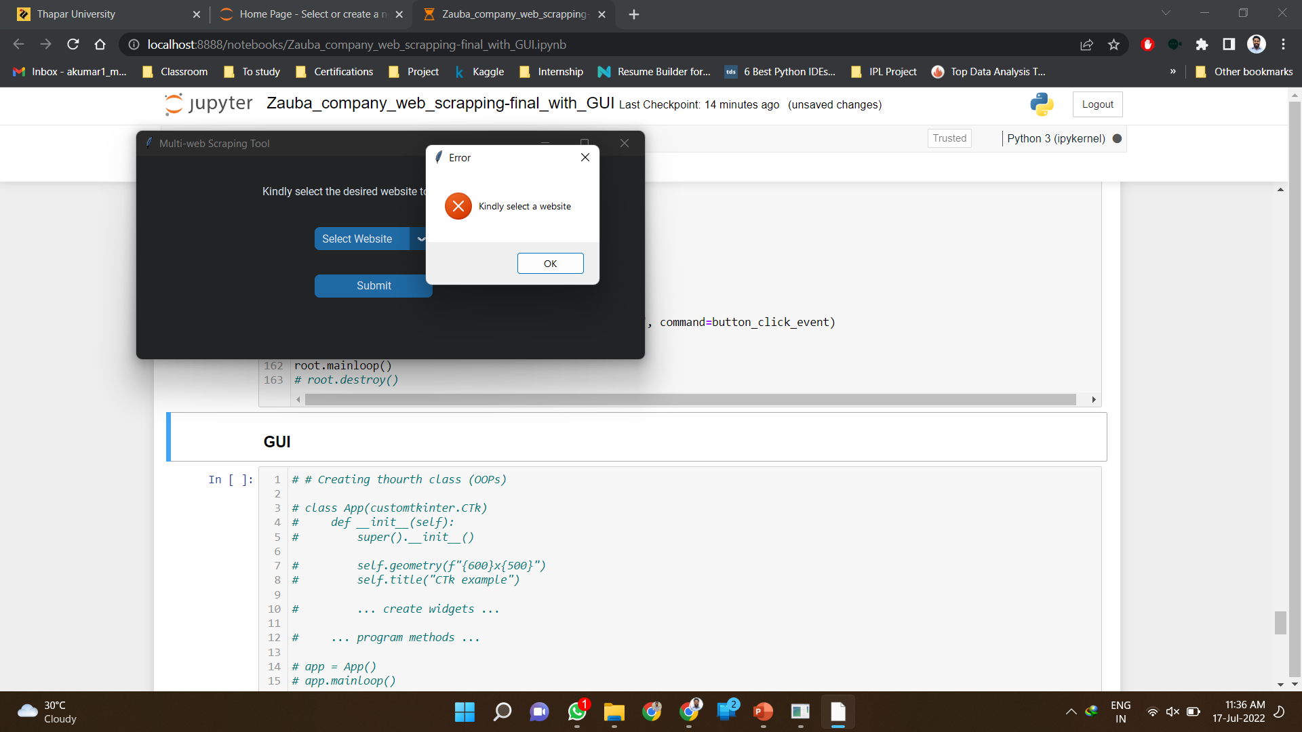
Graphical User Interface (GUI) & Tool
1.
2.
First screen of the tool
Cannot proceed w/o selecting an option

Slide 31
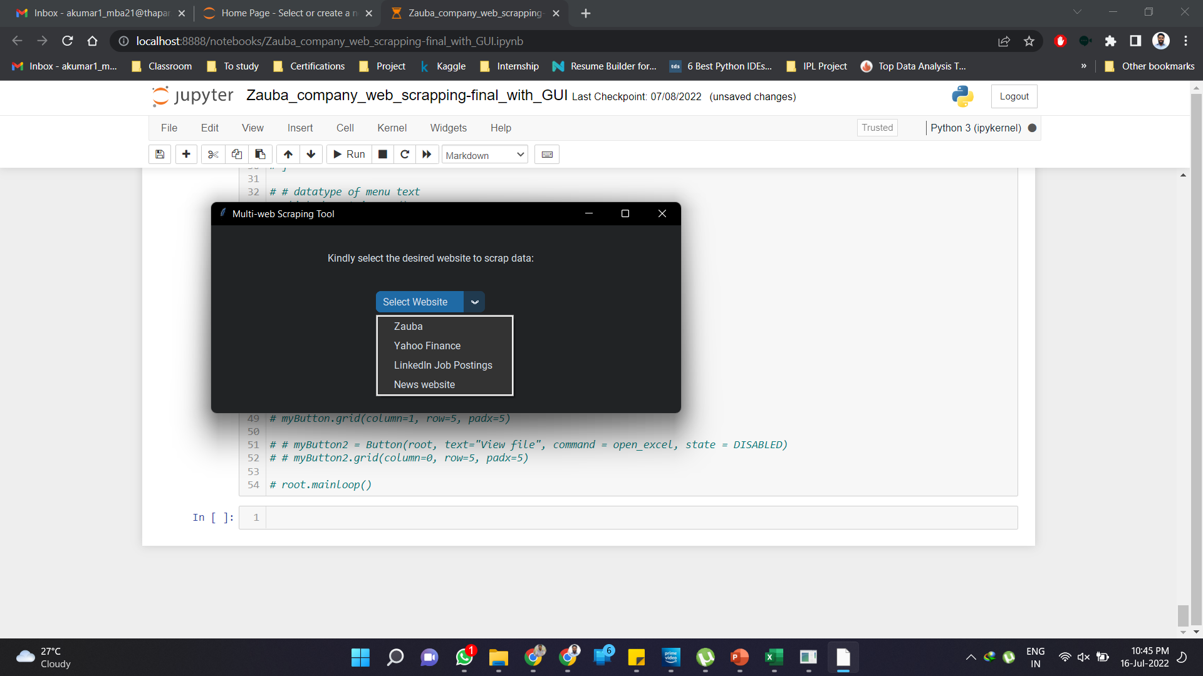
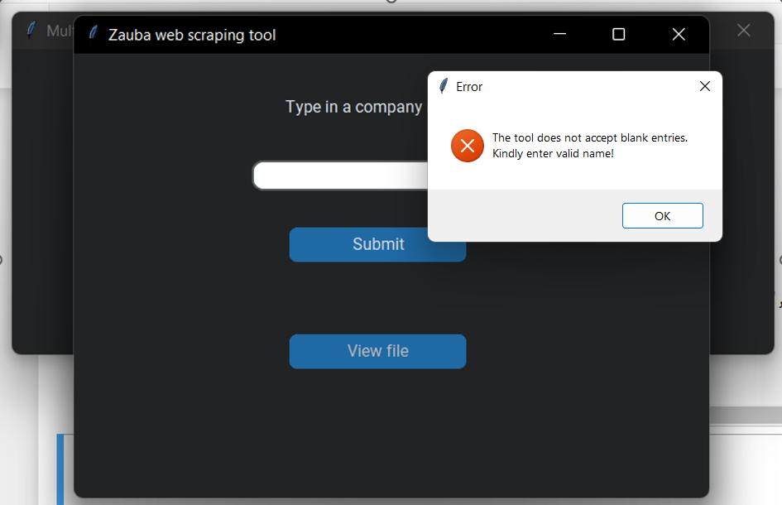
Graphical User Interface (GUI) & Tool
3.
4.
Select a website to scrap
Error on submitting empty value

Slide 32
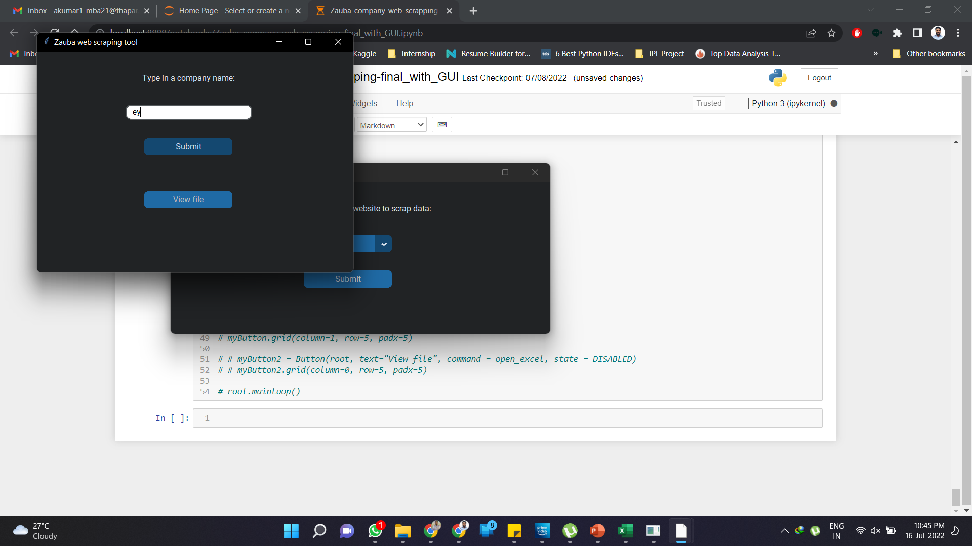
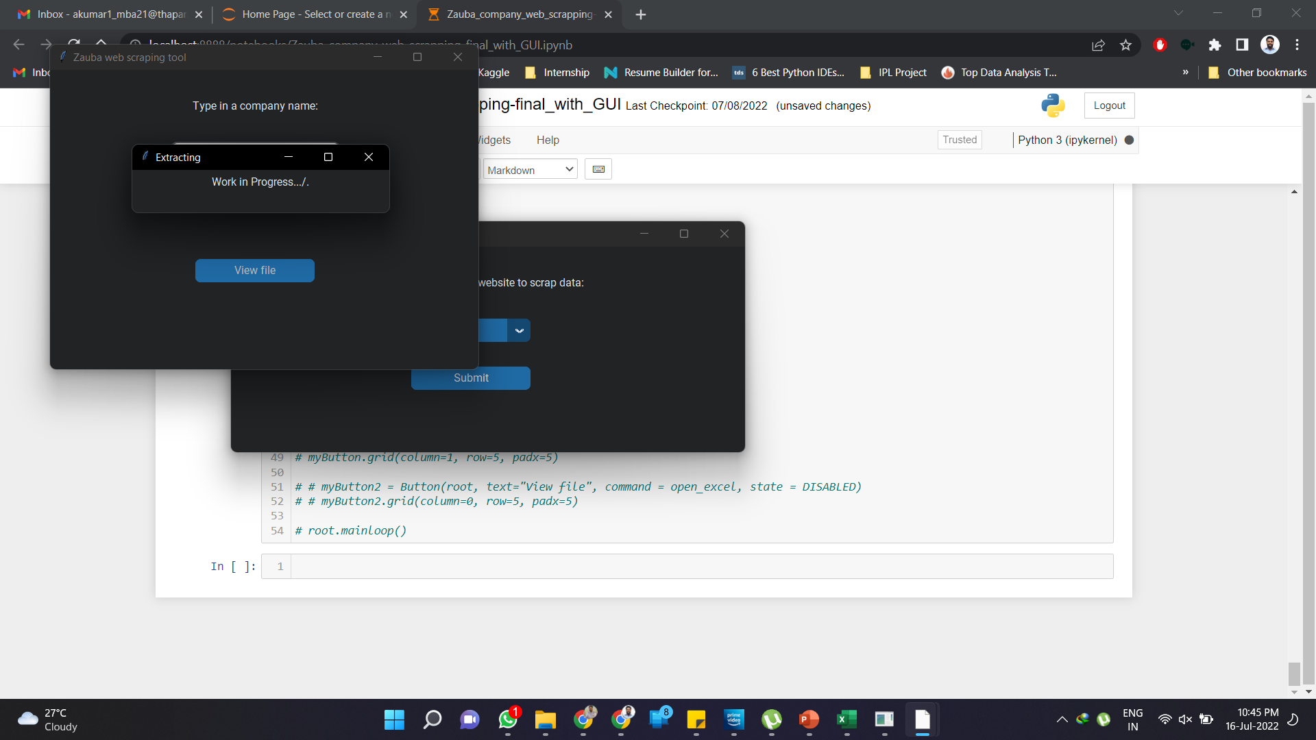
Graphical User Interface (GUI) & Tool
5.
6.
Enter the company name
The Process starts and its Message pops

Slide 33

Challenges faced
Limited Web scrapping libraries and function knowledge.
Javascript in the website data.
Clarity on the choices for project requirements.
Automating the scrapping process
Making codes generalized.
Lengthy codes for UI.
Compilation and Optimization of scraping scripts.
New addition and changes in the project requirement.
This Photo by Unknown Author is licensed under CC BY-SA-NC

Slide 34
Outcomes / Learnings
The project will assist in reducing the effort and time for end-users to search and extract the desired data.
Helped me gain knowledge and skill about Python coding and Excel in an industry environment/ team and how they usually work, how to do the debugging, make professional reports, analyse the final outcomes and make some visualizations.
I have also learnt about project management and problem-solving.

Slide 35

Limitations
Availability of high-speed internet or disconnection is a limitation when the codes are written with a minimum bandwidth in testing and also as per the available connection on which the test run was done and optimized with time settings.
If the disconnection occurs the codes fail or crash and the norm to restart from the last point or history is not done here due to initial stage.
Hence, the whole code is to be run again and the process will start from the beginning.
Lack of a training dataset or secondary data from the client made us to look for it online and that created a difference of parameters and the process to solve the problem.
There is waiting time for the scrapping process and it sometimes act as a limitation for the system as there is load on the hardware and computing power is limited.
This Photo by Unknown Author is licensed under CC BY-SA-NC

Slide 36
This project has helped company to overcome some of the difficulties which they were facing during the client servicing and business development process.
This project has made their work easier to find the information about potential fraud job postings from an unknown user account or agent whom the client has not authorized. A model was made for this purpose and deployed to predict the fakeness.
The model results were visualized, and insights were generated for the client. The tool UI for the same was completed so that the end user can use it with ease on their devices.
This information will help the company to grow and expand in terms of the client service, market size, and through this, the company can use fund to innovate and launch new services and help them increase their market share.
Conclusion

Slide 37

Future Scope
Further the project use and extension can involve:
Some mini web scraping projects to integrate into the tool or
additional changes or requirements in the current ones as per client needs.
Customizations to the module and tool can be made.
A tool application (.exe file) can be easily created using the PyInstaller library in python.

Slide 38
THANK YOU….!!!!

